Slide 1

NAME: E.G.PRADEEP ROLL NO : RA2211004050026 DEP: B.TECH.ECE SUB: DESIGN THINKING METHODOLOGY SUB CODE : 21DCS201P

Slide 2
PROBLEM STATEMENT CANVAS : 1. provides a clear and concise overview of the problem, including its nature, scope, and impact on stakeholders. 2. It helps US clearly define and articulate the problem they are facing, providing a structured framework for understanding its nature, scope, and impact. 3. It supports decision-making by providingUS with a comprehensive overview of the problem and its implications, enabling informed decision-making about resource allocation, priorities, and courses of action. 4.the Problem Statement Canvas is a valuable tool for problem identification, analysis, and solution development, empowering stakeholders to address complex problems more effectively and systematically across a wide range of contexts and applications.

Slide 3
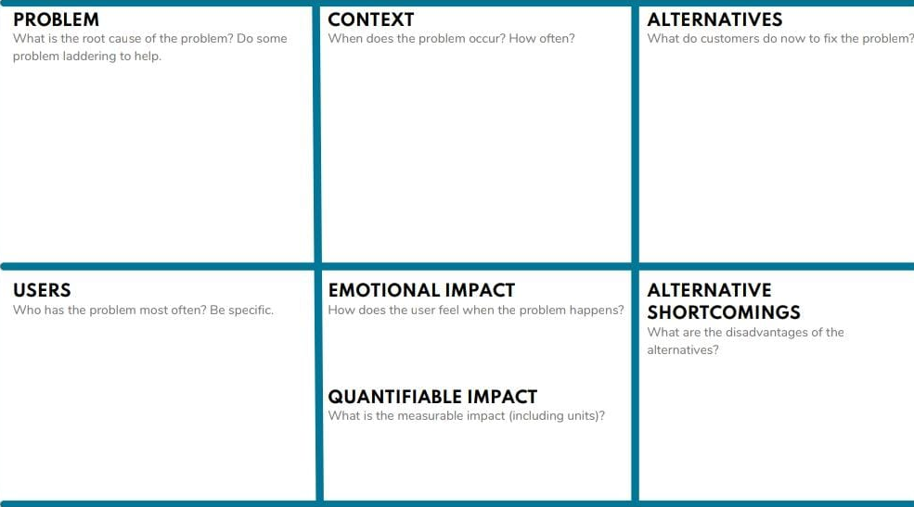
PROBLEM STATEMENT CANVAS TEMPLATE :

Slide 4
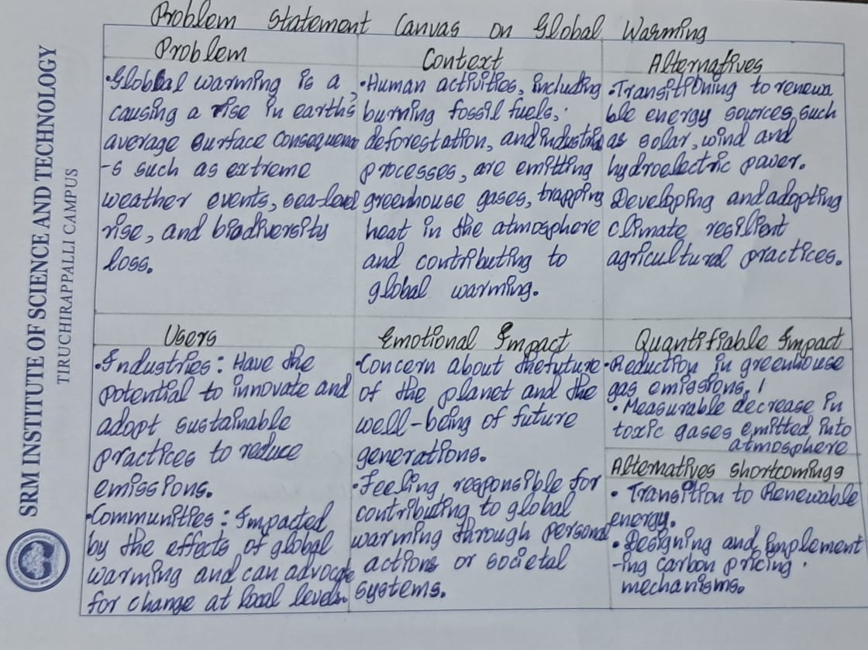
MY ASSIGNMENT :

Slide 5
THANK YOU

